Slide 1
SSD: Single Shot Multibox Detector
Computer vision and pattern recognition
Section: b
Antu Asif Ikbal (17-34554-2)

Slide 2
Table of content
Introduction
Related Work
The Single Shot Detector
Experimental Results
Conclusions

Slide 3
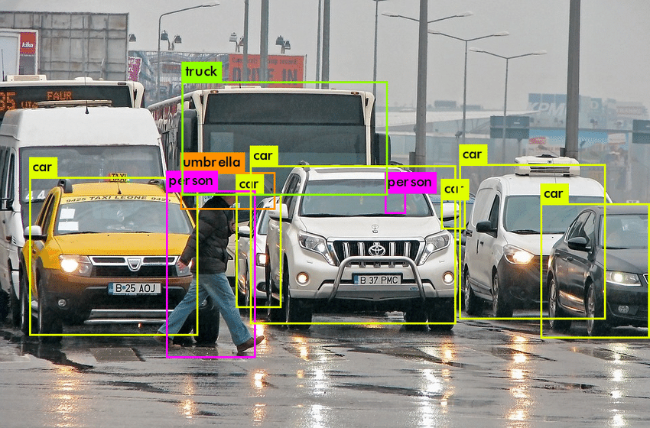
Introduction
Object Detection

Slide 4
The task of object localization and classification done in a single forward pass of the network is Single Shot
A technique named multibox for bounding box regression developed by Szegedy et al.
The network is mainly object detector which also classifies the detected objects.

Slide 5
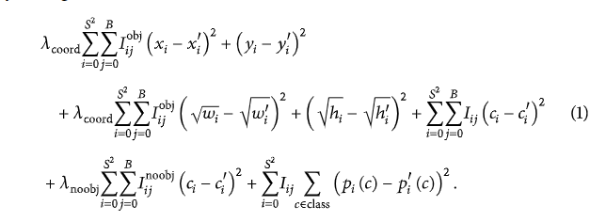
Related Work
Object Detection
In computer vision, object detection refers to finding and identifying an object in an image or video
The loss function of the original YOLOv1 network takes the same error for the large and small objects, which makes the model’s prediction for neighboring objects unsatisfactory. If two objects appear in the same grid, only one object can be detected, and there will be a problem in detecting small objects.

Slide 6
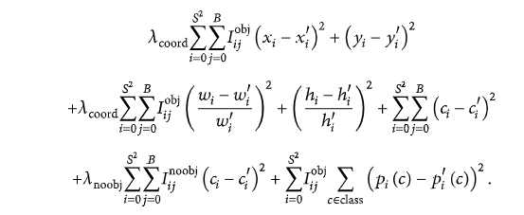
Yolo v1
In the YOLOv1 network loss function design, the variance function is used as part of the entire loss function, the normalization idea of contrast is used to improve it, and the improved model replaces margin style with proportion style, so here the size of the object in the picture is considered.

Slide 7
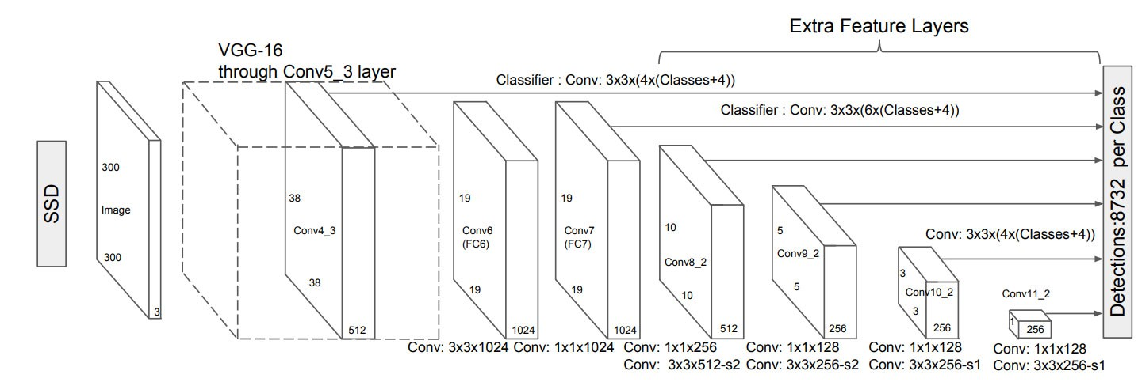
The Single Shot Detector
Model

Slide 8
The Single Shot Detector
Training
Matching Strategy
Training objective
Choosing scales and aspect ratio
Data augmentation

Slide 9
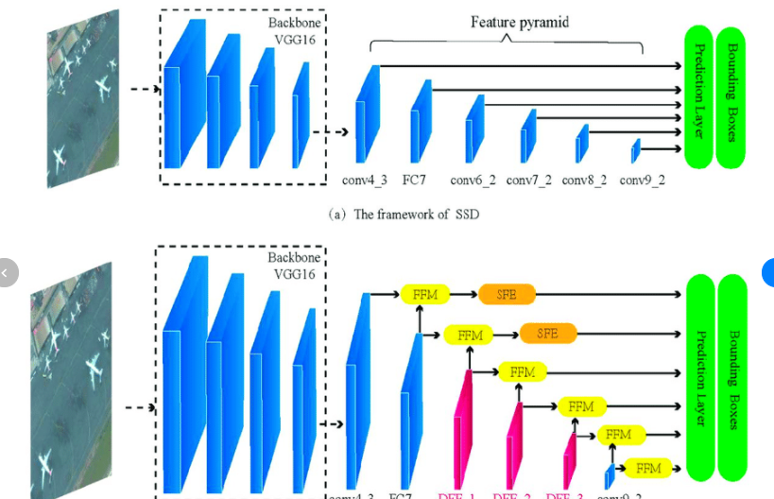
Experimental results
PASCAL VOC2007
In order to evaluate the performance of the algorithm proposed, experiments were carried out on PASCAL VOC 2007 and 2012 datasets.The test results of SSD algorithm based on feature fusion are compared with those of SSD algorithm and Faster RCNN algorithm. And the performance of the proposed method for small object detection is improved compared with the original algorithm. Finally, the real-time performance of the algorithm is compared and analysed.

Slide 10
Experimental results
COCO

Slide 11
Conclusions
SSD is designed for object detection in real-time.
Faster R-CNN uses a region proposal network to create boundary boxes and utilizes those boxes to classify objects. While it is considered the start-of-the-art in accuracy.
the whole process runs at 7 frames per second. SSD speeds up the process by eliminating the need for the region proposal network.
To recover the drop in accuracy, SSD applies a few improvements including multi-scale features and default boxes. These improvements allow SSD to match the Faster R-CNN’s accuracy using lower resulation image , which further pushes the speed higher. According to the following comparison, it achieves the real-time processing speed and even beats the accuracy of the Faster R-CNN

Slide 12
Thank You!

